Slide 1
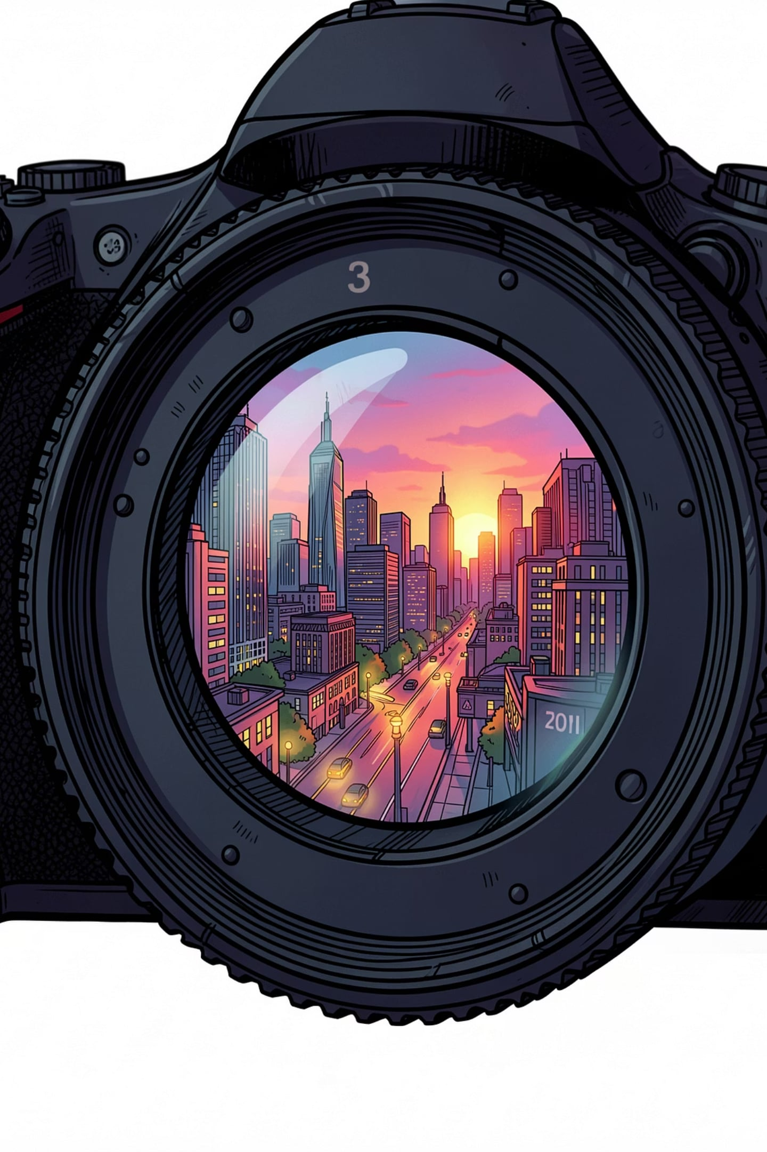
Image Processing vs Computer Vision: Seeing Through the Digital Lens
A concise exploration of two tightly related fields: one that perfects pixels for human viewing, and one that interprets pixels to drive machines. This deck clarifies differences, shared tools, historical milestones and the modern frontier of machine perception.

Slide 2
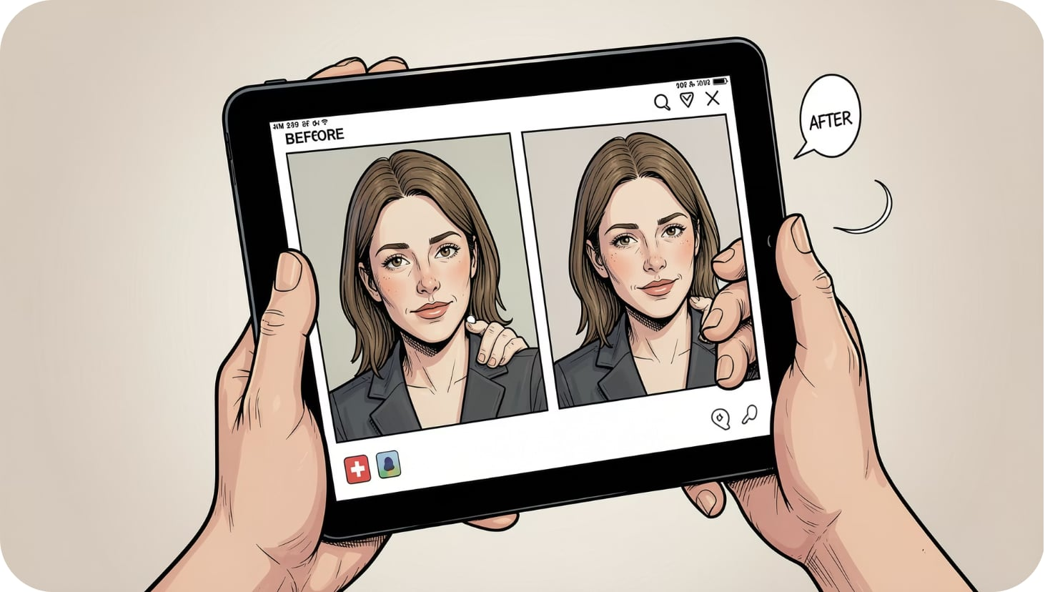

Defining the Spectrum
Image Processing: Transforming raw images into improved versions for human consumption — denoising, restoration, contrast and compression. Typical goal: visually better pixels.
Computer Vision: Algorithms that convert imagery into symbolic, machine-readable information—detection, segmentation, measurement, and decision-making. Typical goal: actionable understanding.
The overlap: both use filtering, feature extraction and optimisation. The distinction lies in objectives: aesthetic fidelity vs. semantic interpretation.
Theme accents use the deck colours (noted in brief): #AAE4FE and complementary blues for emphasis.

Slide 3
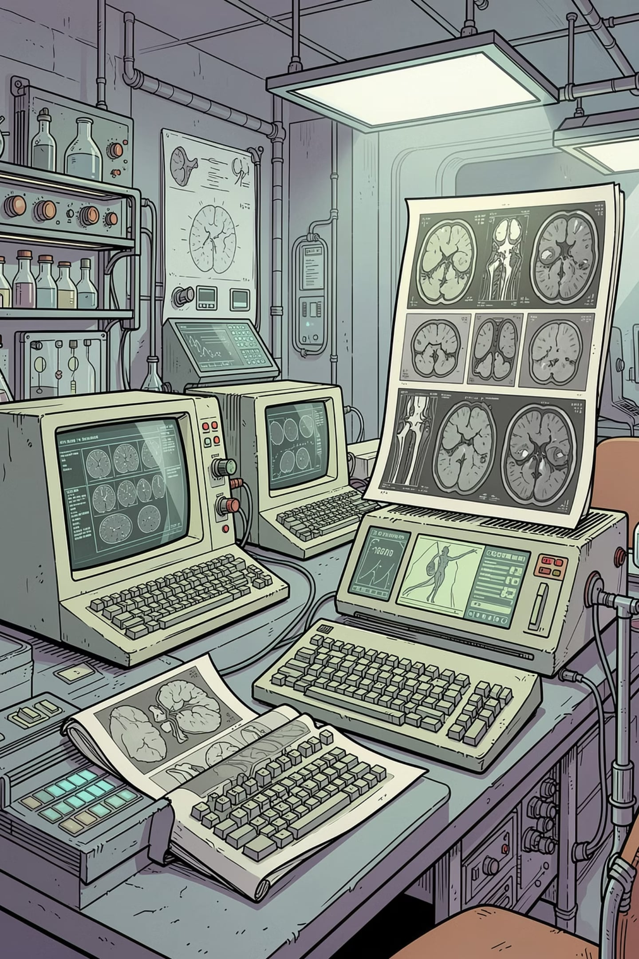
The Era of Enhancement (1960s–1980s)
Image Processing Milestones
Early Computer Vision
Research focused on interpreting simple synthetic scenes and line drawings (MIT and academic prototypes), testing the limits of symbolic image understanding.
Restoration, contrast enhancement and compression techniques matured for medical imaging and remote sensing—practical improvements to how humans read images.
Methodological Shift
By the late 1980s research moved from attempting full scene understanding toward mathematically rigorous, task-specific models.

Slide 4
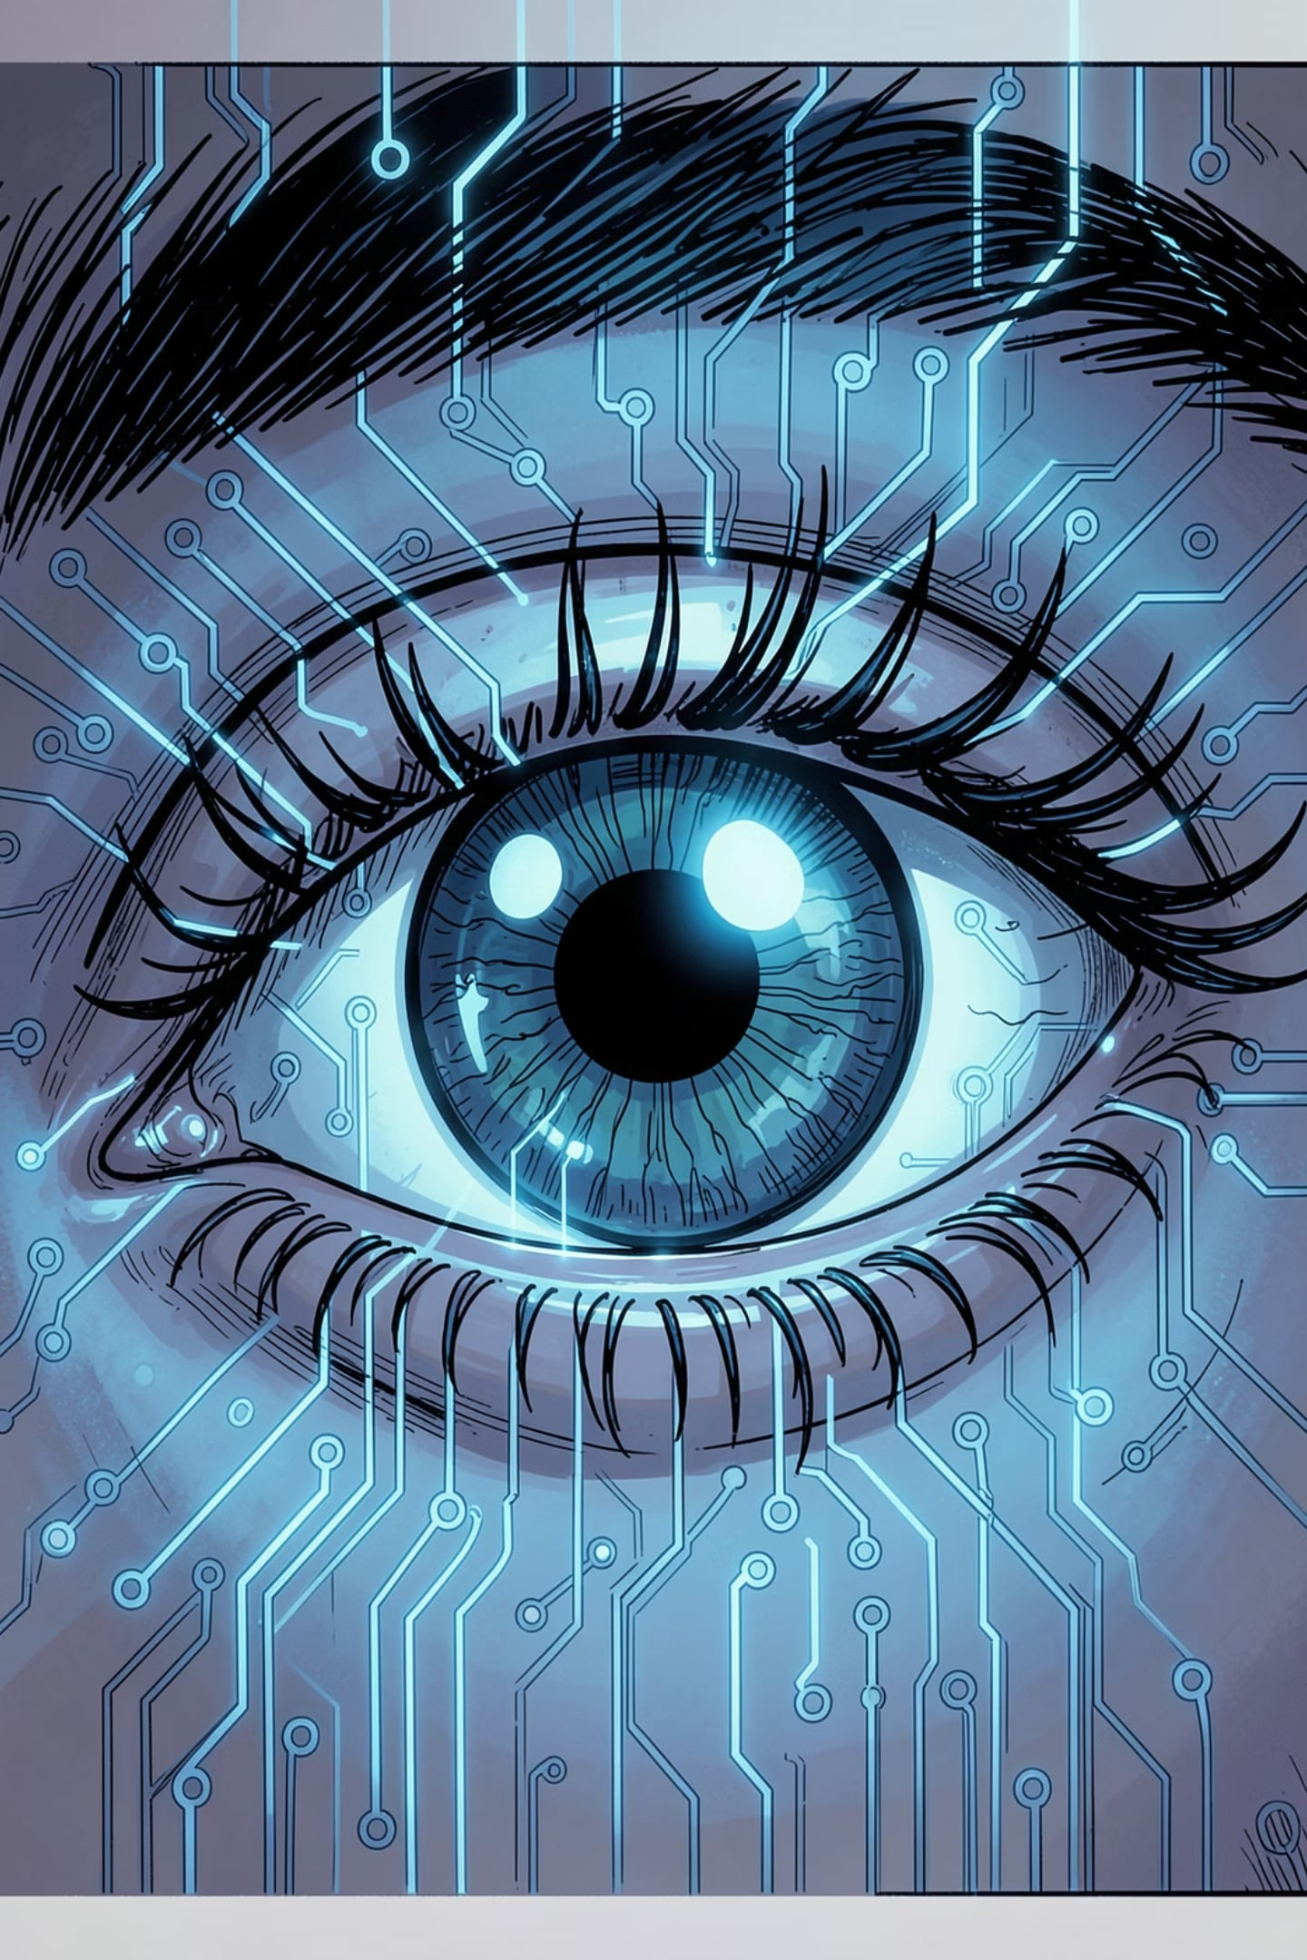
Computer Vision: Giving Eyes to Machines
Bridging human perception and machine intelligence to transform how visual data is understood, acted on and scaled across industries. From pixels to actionable insight — enabling faster decisions, expanded reach and new services.

Slide 5
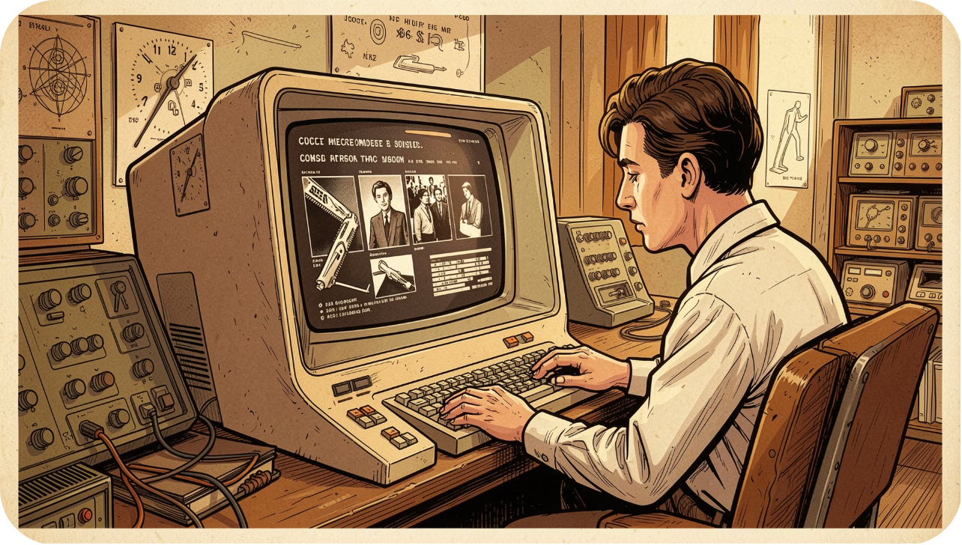
Foundations: From Early Concepts to Digital Reality
Historical milestones
1960s — Birth of machine image processing: basic edge detection and pattern matching.
1970s — David Marr's computational framework: levels of vision (computational, algorithmic, implementational).
1990s–2010s — Feature engineering to statistical learning: SIFT, HOG, support vectors and boosted trees.
Technical pillars — AI models, signal processing, optimisation, and inspiration from neurobiology shape modern pipelines (preprocessing, representation, detection, understanding).

Slide 6


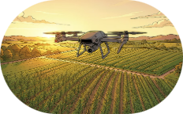
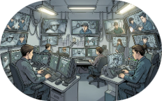
Scaling Impact: Industry Transformations
Healthcare
Retail
Agriculture
Surveillance
AI augments diagnosis — automated X‑ray/MRI analysis, triage prioritisation and early disease detection to reduce time-to-treatment.
Shelf analytics, inventory tracking and cashier‑free checkout streamline operations and personalise customer experiences.
Drone and satellite vision enable precision farming: crop-health maps, pest detection and optimised irrigation for higher yields.
Real‑time pattern detection and behaviour analytics improve public safety, while raising important questions about privacy and governance.
Each sector applies core CV capabilities (detection, segmentation, tracking, recognition) to distinct workflows — delivering efficiency, scale and new services while requiring domain integration and ethical oversight.

Slide 7
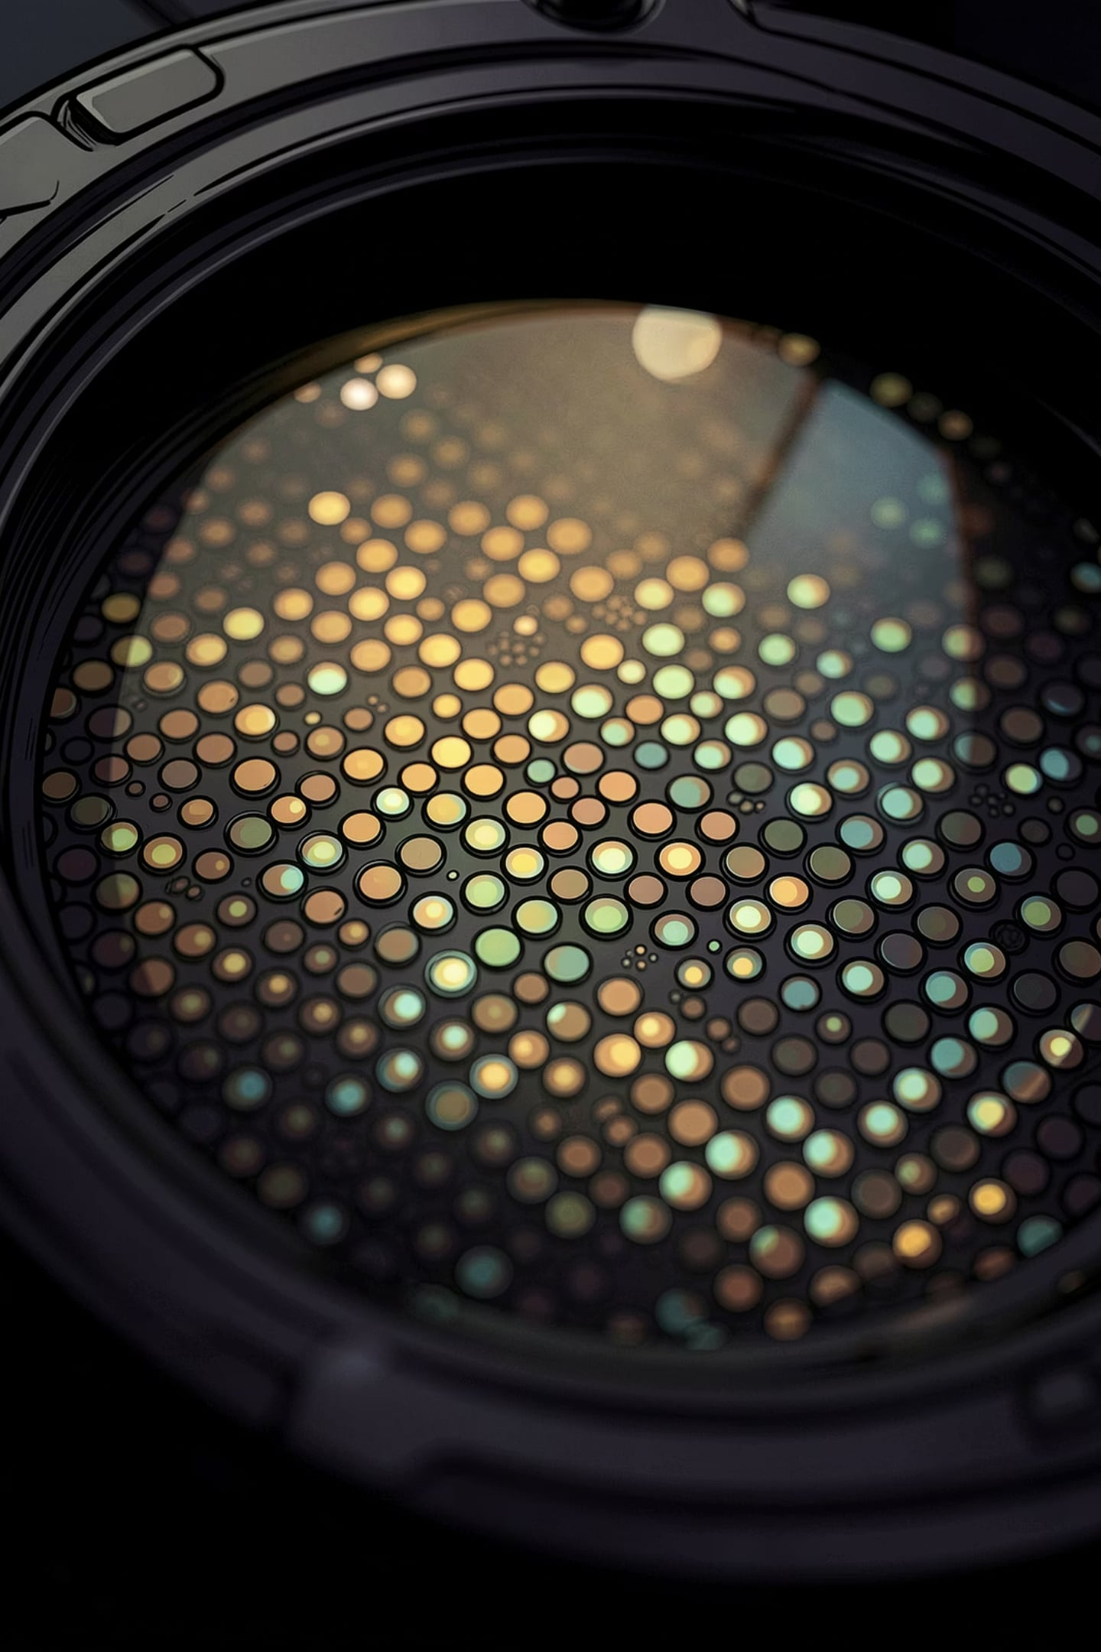
Digital Image Fundamentals: From Light to Pixels
How continuous light becomes discrete digital information. This short deck explains sensors, pixels, sampling, resolution and quantization — the core ideas designers and engineers use to control image quality, file size and visual fidelity.

Slide 8
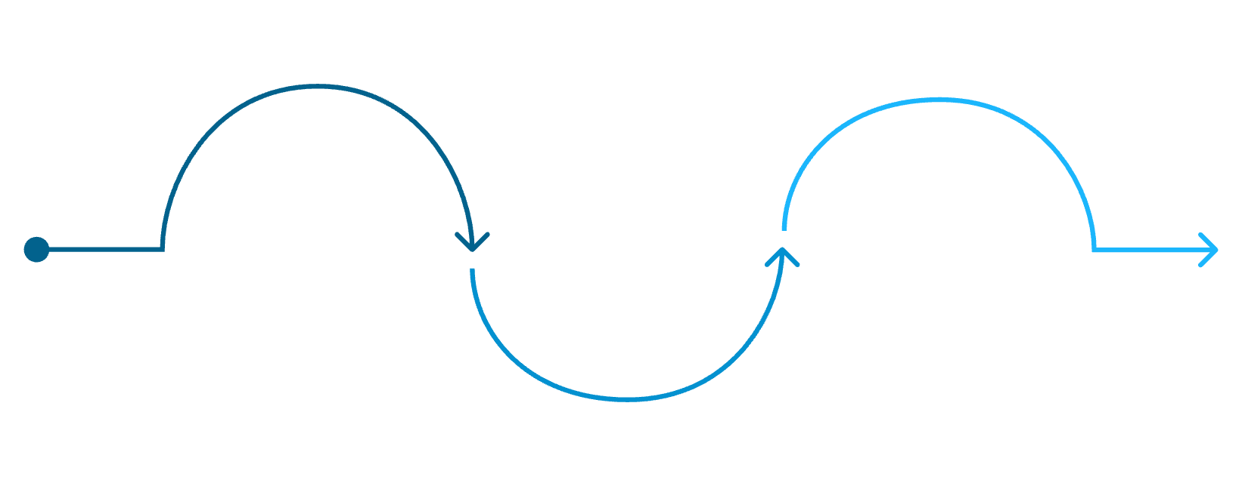

Sampling & Resolution: How Detail Is Captured
Key concepts
Sampling rate: pixels per inch (ppi) or dots per inch (dpi) — higher values capture smaller details.
Aliasing: coarse sampling misrepresents high-frequency detail (jaggies, moiré). Use anti‑aliasing or higher sampling to reduce it.
Practical targets: on-screen work often uses 72–150 ppi; print and professional images typically require 200–300 ppi or more.
Continuous light
Fine sampling
Unsampled scene with full detail
Coarse sampling
High spatial resolution, smooth details
Visible blockiness and aliasing risks
Sampling overlays a grid on the continuous scene. More samples per unit area = higher spatial resolution and finer detail.
Workflow note: Increasing resolution increases memory and processing cost — balance needs vs resources.

Slide 9
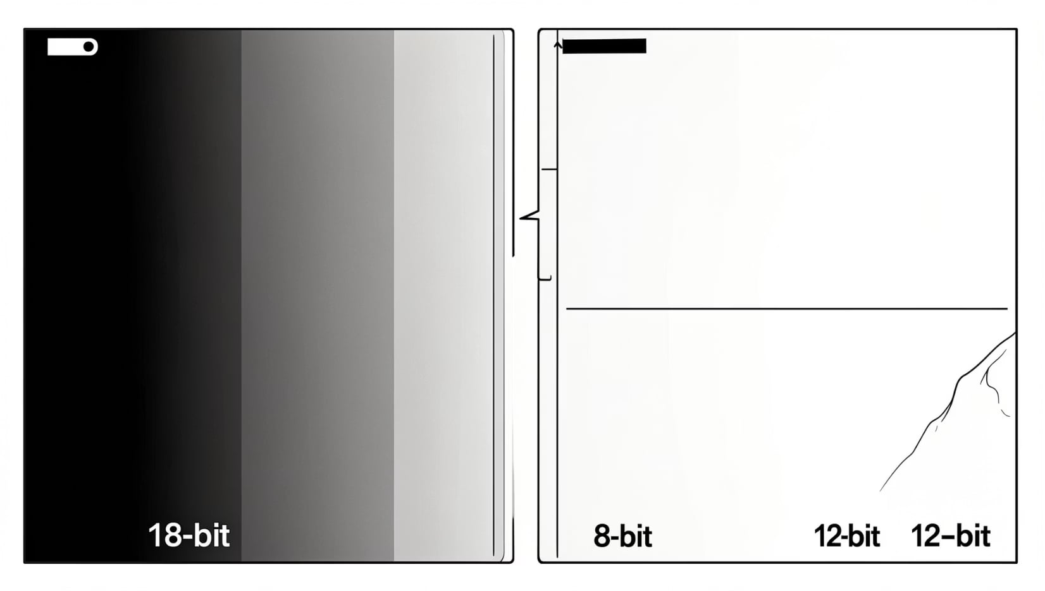
Quantization & Grayscale Depth — Shades of Accuracy
How brightness becomes numbers
Quantization maps continuous luminance to discrete numeric levels per pixel. Bit depth sets the number of available shades and determines subtlety in tones.
In practice, image fidelity is a joint function of sampling (spatial detail) and quantization (tonal precision). Optimise both to match your display, workflow and storage constraints.
8-bit
10–12 bit
Trade-offs
256 levels — standard for many images and displays; small gradients may show banding.
1,024–4,096+ levels — used in professional photo, video and medical imaging for smoother tonal transitions and analysis.
Higher bit depth increases fidelity but also file size and processing demands. Choose depth to fit the application.

